Slide 1

Reservoir connection probability
Reservoir :- 3D or 2D grid of neurons with $P_{connection}\left(N1,N2\right)$ as the probability of connection of 2 neurons in the grid
Neurons can be considered as Leaky Integrate and Fire (LIF), with 80% excitatory, 20% inhibitory.

Slide 2
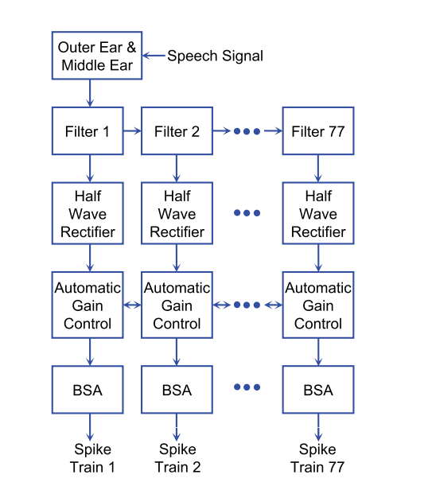
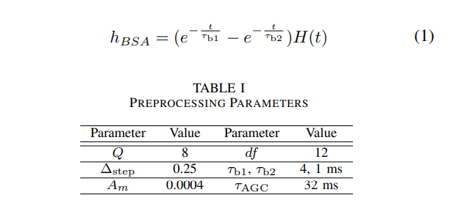
Speech pre-processing

